Slide 1
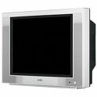

TV HEAVEN
RECYCLE your old Bulky & Heavy TV screens!
We pick up from your home any TV size & drop off to
an approved Alberta Recycling site NOT a landfill
Call us today for an estimate
7 days a week (9:00 AM – 9:00 PM)
Seniors Discount – 10% off all services
Phone: 403-837-3650
Email: tvheaven@shaw.ca
10%
An Alberta Registered Corporation.

